Slide 1
Global Office 365 Bootcamp – Madrid, Spain
Alberto Diaz Martin
CTIO at ENCAMINA – Azure MVP

Slide 2




Alberto Diaz Martin
@adiazcan
Alberto Diaz cuenta con más de 14 años de experiencia en la Industria IT, todos ellos trabajando con tecnologías Microsoft. Actualmente, es Chief Technology Innovation Officer en ENCAMINA, liderando el desarrollo de software con tecnología Microsoft, y miembro del equipo de Dirección.
Para la comunidad, trabaja como organizador y speaker de las conferencias más relevantes del mundo Microsoft en España, en las cuales es uno de los referentes en SharePoint, Office 365 y Azure. Autor de diversos libros y artículos en revistas profesionales y blogs, en 2013 empezó a formar parte del equipo de Dirección de CompartiMOSS, una revista digital sobre tecnologías Microsoft.
Desde 2011 ha sido nombrado Microsoft MVP, reconocimiento que ha renovado por séptimo año consecutivo. Se define como un geek, amante de los smartphones y desarrollador. Fundador de TenerifeDev (www.tenerifedev.com), un grupo de usuarios de .NET en Tenerife, y coordinador de SUGES (Grupo de Usuarios de SharePoint de España, www.suges.es)

Slide 3
The evolution of application platforms
On-Premises
IaaS
PaaS
Serverless

Slide 4
What is the right size of
servers for my business needs?
How do I deploy new code to my server?
What happens in case of
server hardware failure?
What media should I
use to keep backup?
Which packages should be on my server?
What size of servers
should I buy?
Who monitors
my App?
How often should I backup my server?
How can I scale my app?
How can I increase server utilization?
Who has physical
access to my servers?
Which OS should I use?
Do I need secondary network connection?
Are my server in a
secure location?
Who monitors
my Servers?
What happens if the
power goes out?
Do I need a UPS?
What storage I need to use?
How many servers
do I need?
How can I dynamically configure my app?
It takes how long to provision a new server?
How often should
I patch my servers?
On-Premises
The “evolution” of application platforms

Slide 5
What is the right size of servers for my business needs?
How can I increase server utilization?
How many servers do I need?
How can I scale my app?
How often should I patch my servers?
How do I deploy new code to my server?
How often should I backup my server?
Which OS should I use?
Which packages should be on my server?
Who monitors my App?
On-Premises
IaaS
The “evolution” of application platforms

Slide 6
What is the right size of “servers” for my business needs?
How can I increase “server” utilization?
How many “servers” do I need?
How can I scale my app?
On-Premises
IaaS
PaaS
The “evolution” of application platforms

Slide 7
How do I architect my app?
Serverless, the platform for next gen apps
On-Premises
IaaS
PaaS
Serverless
The “evolution” of application platforms

Slide 8
What is Serverless?
Abstraction of servers
Event-driven/ instant scale
Micro-billing

Slide 9
Benefits of Serverless
Manage apps, not servers
Reduced DevOps
Faster time to market

Slide 10








Serverless application platform components
Development
Platform
IDE support
Functions
Logic apps
Event Grid
Integrated DevOps
Developer productivity
Visual designer
Manage all events in one place
Triggers and Bindings
100+ connectors
Near real-time delivery
Local development
Flexible deployment options
Functions orchestration
Broad coverage
Monitoring
Database
Storage
Security & Access Control
IoT
Analytics
Intelligence
Visual Debug History

Slide 11
Azure Functions Features
Choice of Languages
Choose the language that can best solve the problem. Mix-and-match
Simplified Integration
Integrate with Azure services and third-party services
Pay-per-use
Pay only for when your function executes
Open source
Runtime, scripting, VS tooling, and portal developed in the open in GitHub

Slide 12

“Frictionless”

Slide 13



App Service (PaaS)
Remote Debugging
Fully Managed
Scale Out
Scale Up
Monitoring
Language Support
Automated Scaling
App Settings
Kudu
VPN
Alerts
SSL
CORS
OAuth Authentication
ARM Deployment
Custom Domains
Continuous Integration
Backups
FTP
Deployment Slots
GitHub
VSTS
Web Deploy

Slide 14




Event-based Processing
Events
Code

Slide 15
What Kind of Events?
Manual | Schedule
Storage Queue | Storage Blob
Service Bus | Event Hub
HTTP | Webhooks
GitHub

Slide 16
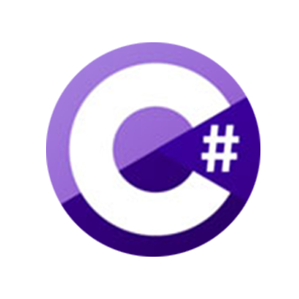


Supported Languages
First-Class Support
Experimental Support
PowerShell
Python
PHP
Batch
Bash
Typescript

Slide 17
What Can You Build?
HTTP Backend
Integrate with third-parties
Web and Mobile backends
Webhook endpoints
Data Processing
Data Ingestion
Internet of Things (IoT)
Image Processing, Data Pipelines
Maintenance Task
Timer and manual execution
Clearing out old files
Index a database

Slide 18



Processing Pipeline
Manual
Queue
Http
Blob
Queue Trigger

Slide 19
Function Hosting Plans
App Service Plan
Consumption Plan
Select amount of resources (App Service Plan size)
Pre-determined pricing
You determine scaling (metric & threshold)
Pay for what you use
Platform determines scaling
“Traditional” App Service Plan
“Dynamic” Plan - Serverless

Slide 20
Storage Queue
Durable message queueing
First In, First Out
Decouples application components
Polling

Slide 21
Processing Pipeline – Current Status
Queue
Manual
Queue Trigger

Slide 22
Storage Blob
Object storage for unstructured data
Massively-scalable
Geo-redundant
Hot or cool storage

Slide 23
Processing Pipeline – Current Status
Manual
Queue
Http
Blob
Queue Trigger

Slide 24
Supported Triggers & Bindings
Type | Service | Trigger | Input | Output
Schedule | Azure Functions | ✔
HTTP (REST or webhook) | Azure Functions | ✔ |  | ✔*
Blob Storage | Azure Storage | ✔ | ✔ | ✔
Queues | Azure Storage | ✔ |  | ✔
Tables | Azure Storage |  | ✔ | ✔
Tables | Azure Mobile Apps |  | ✔ | ✔
No-SQL DB | Azure DocumentDB |  | ✔ | ✔
Push Notifications | Azure Notification Hubs |  |  | ✔
Twilio SMS Text | Twilio |  |  | ✔
… more
* - The HTTP output binding requires an HTTP trigger

Slide 25
Local Development

Slide 26

Local Development: Visual Studio (Preview)
Pre-requisites
Visual Studio 2017 Preview 3
ASP.NET and web development, or
Azure development
Visual Studio 2017 Tools for Azure Functions extension

Slide 27
Scaling Out

Slide 28
Scaling Out an Azure Function
Function App
The unit of scale
Function App
Function App
Function App
ManualTrigger
HttpTrigger
QueueTrigger
ManualTrigger
HttpTrigger
QueueTrigger
ManualTrigger
HttpTrigger
QueueTrigger

Slide 29
App Service Plan Scaling
You will:
Need to have correct Service Plan
Basic – Manual
Standard or Premium – Automatic Scaling
Set up metric to trigger scaling by

Slide 30
Consumption Plan Scaling
Azure Functions will:
Monitor
Incoming events/requests
Amount of resources each function is taking
Automatically scale out
Provision additional VM instances as required

Slide 31
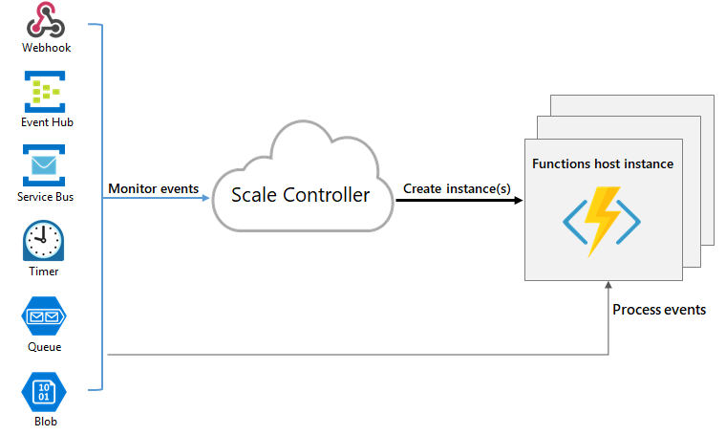
Scale Controller (Consumption Plan)
Source

Slide 32
Pricing

Slide 33
Consumption Plan Pricing
Pay per execution model
Executions = Number of executions
GB-sec = Duration of execution x memory usage
Azure Functions price
$0.20/1M executions
$0.000016 /GB-sec

Slide 34
Consumption Plan Pricing
Free Grant
1,000,000 free executions
400,000 free GB-sec

Slide 35
Example pricing
Scenario: API Application
10 million requests a month
Average 0.5 sec execution duration
Average 512 MB memory usage
Math:
10M reqs * (0.5 sec * 0.5 GB) per request = 2.5M GB-sec
Billable units:
2.5M GB-sec – 400k GB-sec grant = 2.1M GB-sec ~= $33.60
10M requests – 1M free grant = 9M requests ~= $1.80

Slide 36
Best Practices

Slide 37
Chose one over the other
App Service Plan | Consumption
Plan on running often or continuously | One-off or once in a while - 10 minute limit
Have excess capacity on App Service | Don’t want to worry about setting scaling rules
Want predetermine cost | Don’t want to pay for an App Service Plan
> 15 MB file on HTTP Triggered | Maximum memory: 1.5GB

Slide 38
Best Practice
Avoid long-running functions
Use queues to communicate between functions
Queues, Topics, EventHub
Functions should be stateless
If need state, keep it in queue messages

Slide 39
Best Practice (cont.)
Write defensive functions
Allow for retry logic
Use dead-letter queues
Use async code

Slide 40
Dual Abstraction with Azure Functions
Serverless Abstraction
Abstract away the scaling of compute
1
Binding and Triggers
Abstract away the services you interact with
2

Slide 41
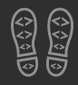
Enjoy the Bootcamp

